Slide 1
KJKFC 2024 Strategic Plan Member Survey Results
Notes:
This presentation was automatically generated by PowerPoint Copilot based on content found in this document: https://chevron-my.sharepoint.com/personal/rsem_chevron_com/Documents/Microsoft%20Copilot%20Chat%20Files/KJKFC%20Data_All_240719.pdf AI-generated content may be incorrect.

Slide 2
KJKFC Vision & Values

Slide 3
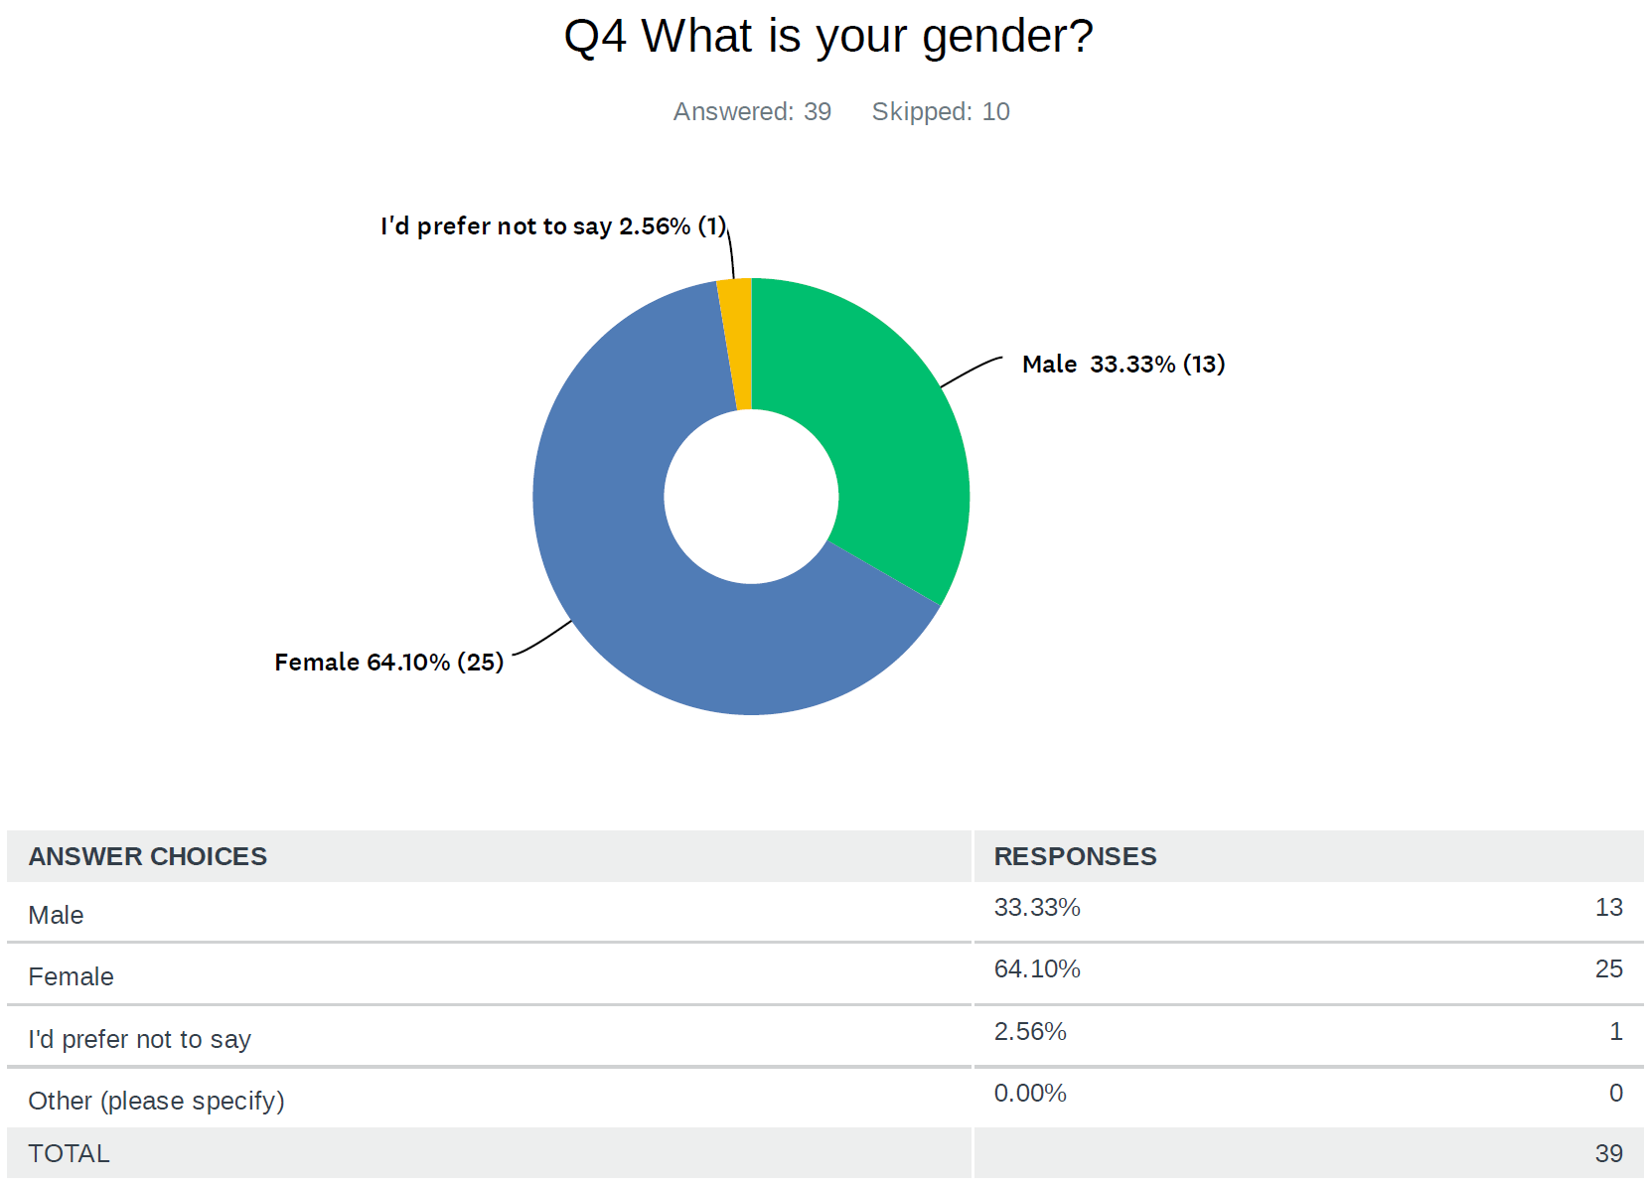
Survey Demographic

Slide 4
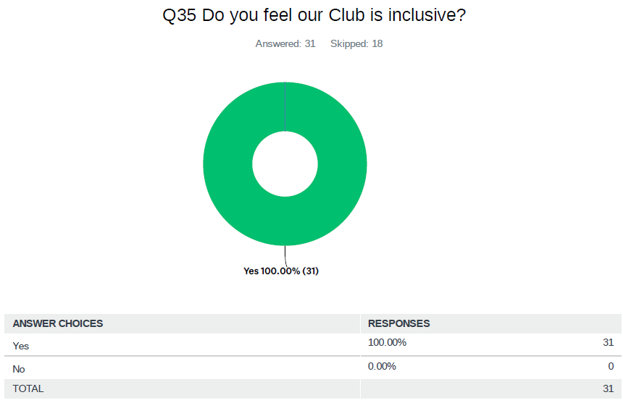
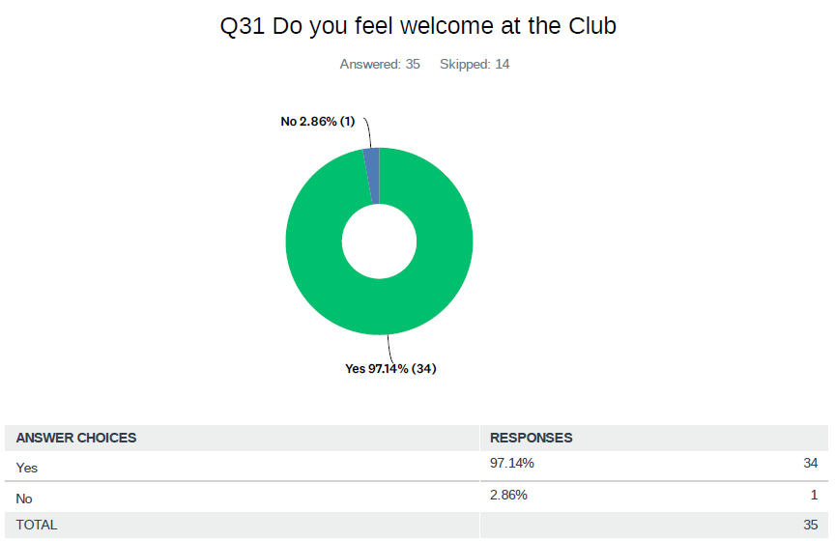
Is the Club Welcoming & Inclusive?
Notes:
The survey results show that 40% are very satisfied with club communication, while 48.57% are satisfied. Comments were provided by 9 respondents. Regarding canteen purchases, 5.71% never buy food or drink. Original Content: Q19 Please rate how satisfied you are with the communication received from the Club Answered: 35 Skipped: 14 Very Satisfied 40.00% (14) Dissatisfied 2.86 % (1) Neither Dissatisfied nor Satisfied 8.57 % (3) Satisfied 48.57 % (17) Q20 Do you have any comments in relation to the Clubs communication? Answered: 9 Skipped: 40 Q21 On average, how often do you purchase food/drink from the canteen when it is open? Answered: 35 Skipped: 14 Never 5.71 % (2) Rarely 14.29% (5) Every second game day Every game day 60.00% (21) 20.00 % (7)

Slide 5
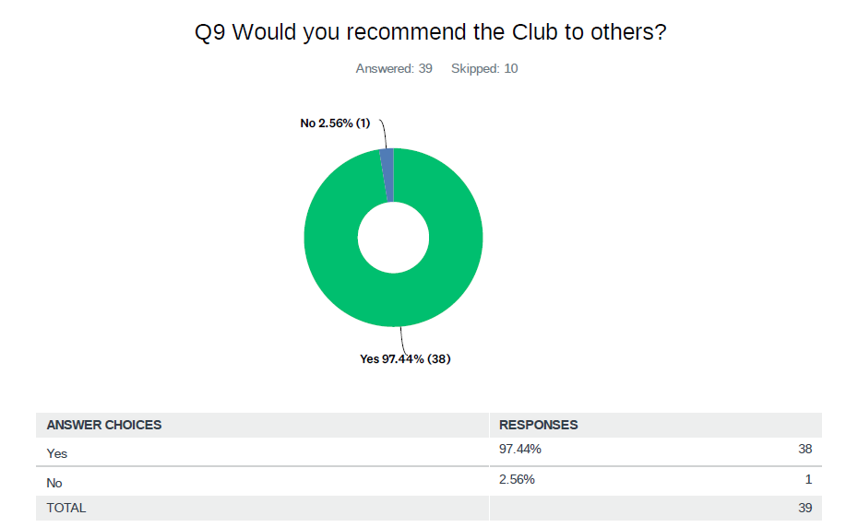
Recommendation of the Club
Survey on Club Recommendation
Positive Responses
97.44% of participants recommend the Club
38 participants responded positively
Negative Responses
2.56% of participants do not recommend the Club
1 participant responded negatively
Notes:
The survey on club recommendation had 39 respondents. 97.44% recommended the club, while 2.56% did not. Original Content: Q9 Would you recommend the Club to others? Answered: 39 Skipped: 10 Yes 97.44 % (38) No 2.56 % (1)

Slide 6
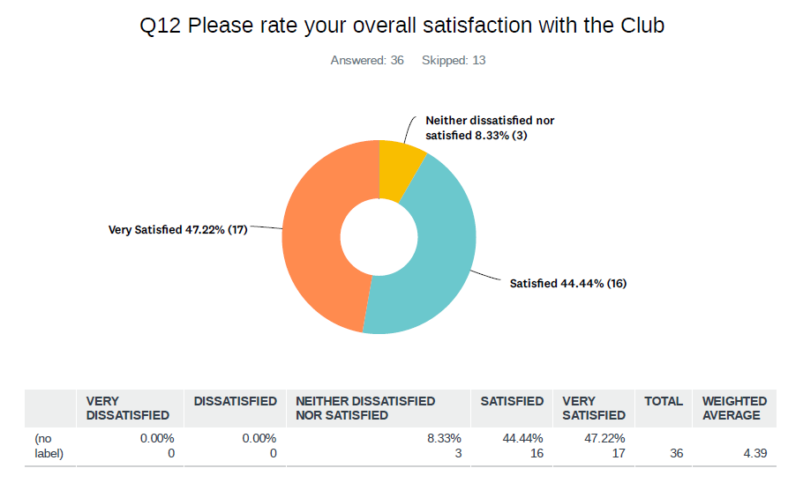
Overall Satisfaction
Overall Satisfaction Ratings
Very Satisfied: 47.22% (17)
Satisfied: 44.44% (16)
Neither dissatisfied nor satisfied: 8.33% (3)
Notes:
The survey on overall satisfaction with the club had 36 responses and 13 skips. 47.22% were very satisfied, 44.44% were satisfied, and 8.33% were neither dissatisfied nor satisfied. Original Content: Q12 Please rate your overall satisfaction with the Club Answered: 36 Skipped: 13 Very Satisfied 47.22% (17) Neither dissatisfied nor satisfied 8.33 % (3) Satisfied 44.44 % (16)

Slide 7
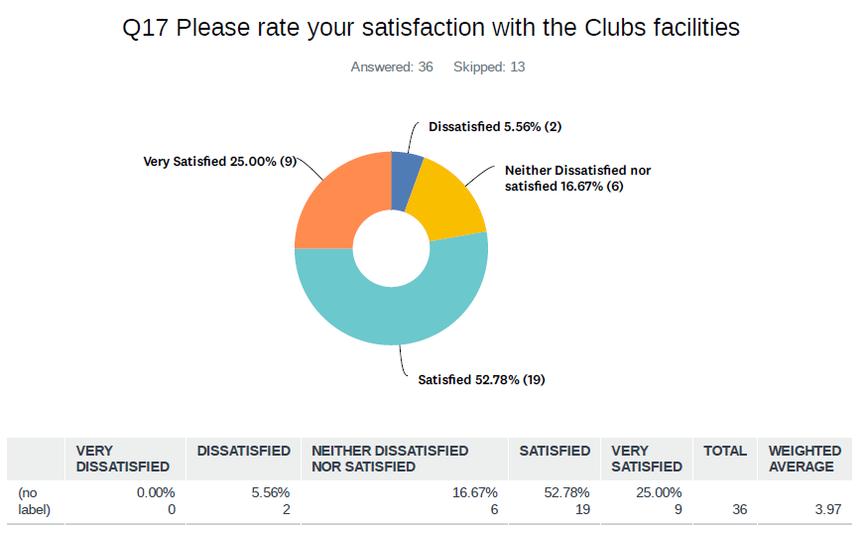
Satisfaction with Facilities
Levels of Satisfaction
Dissatisfied: 5.56% (2)
Very Satisfied: 25.00% (9)
Neither Dissatisfied nor Satisfied: 16.67% (6)
Satisfied: 52.78% (19)
Notes:
The survey on club facilities had 36 responses and 13 skips. Satisfaction levels were varied, with 52.78% satisfied and 25% very satisfied. Original Content: Q17 Please rate your satisfaction with the Clubs facilities Answered: 36 Skipped: 13 Dissatisfied 5.56% (2) Very Satisfied 25.00% (9) Neither Dissatisfied nor satisfied 16.67% (6) Satisfied 52.78% (19)

Slide 8
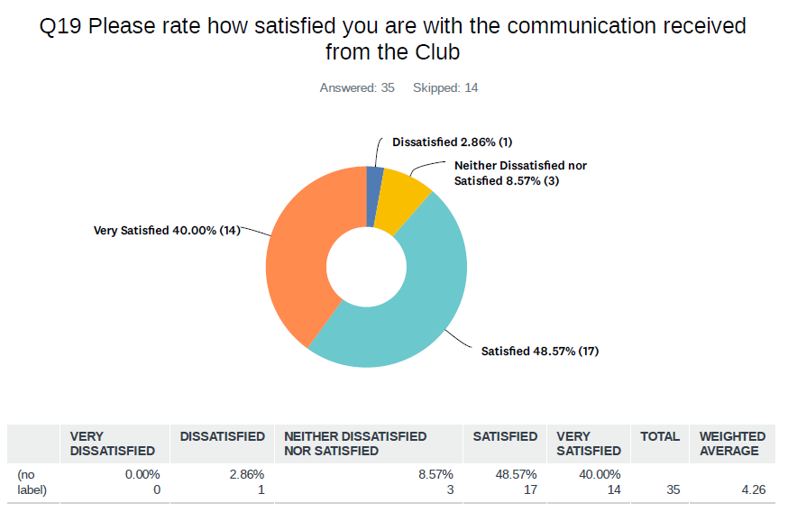
Satisfaction with Communication
Communication Satisfaction
Very Satisfied: 40.00% (14)
Satisfied: 48.57% (17)
Neither Dissatisfied nor Satisfied: 8.57% (3)
Dissatisfied: 2.86% (1)
Notes:
The survey results show that 40% are very satisfied with club communication, while 48.57% are satisfied. Comments were provided by 9 respondents. Regarding canteen purchases, 5.71% never buy food or drink. Original Content: Q19 Please rate how satisfied you are with the communication received from the Club Answered: 35 Skipped: 14 Very Satisfied 40.00% (14) Dissatisfied 2.86 % (1) Neither Dissatisfied nor Satisfied 8.57 % (3) Satisfied 48.57 % (17) Q20 Do you have any comments in relation to the Clubs communication? Answered: 9 Skipped: 40 Q21 On average, how often do you purchase food/drink from the canteen when it is open? Answered: 35 Skipped: 14 Never 5.71 % (2) Rarely 14.29% (5) Every second game day Every game day 60.00% (21) 20.00 % (7)

